Slide 1
CSC 3210 Computer Organization and Programming
Chapter 6: Conditional Processing
if A > B ...
while X > 0 and X < 200 ...
if check_for_error( N ) = true
Notes:
An operator is a symbol that tells the compiler to perform specific mathematical or logical functions.
C language built-in operators
- Arithmetic Operators
- Relational Operators
- Logical Operators
- Bitwise Operators
- Assignment Operators

Slide 2
Outline
Boolean and Comparison Instructions
Conditional Jumps
Conditional Structures
Conditional Control Flow Directives

Slide 3
Boolean and Comparison Instructions
CPU Status Flags
AND Instruction
OR Instruction
XOR Instruction
NOT Instruction
Applications
TEST Instruction
CMP Instruction
if A > B ...
while X > 0 and X < 200 ...
if check_for_error( N ) = true
Boolean operations are the core of all decision statements because they affect the CPU status flags.

Slide 4
Status Flags - Review
Boolean instructions affect the Zero, Carry, Sign, Overflow, and Parity flags.

Slide 5
Status Flags - Review
The Zero flag is set when the result of an operation equals zero.
The Carry flag is set when an instruction generates a result that is too large (or too small) for the destination operand.
The Sign flag is set if the destination operand is negative, and it is clear if the destination operand is positive.
The Overflow flag is set when an instruction generates an invalid signed result.
The Parity flag is set when an instruction generates an even number of 1 bits in the low byte of the destination operand.

Slide 6
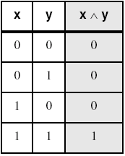
AND Instruction
Performs a Boolean AND operation between each pair of matching bits in two operands
Syntax:
AND destination, source (same operand types as MOV)
AND

Slide 7
AND Instruction
Flags
The AND instruction always clears the Overflow and Carry flags.
It modifies the Sign, Zero, and Parity flags
Consistent with the value assigned to the destination operand.
Example:
Suppose the following instruction results in a value of Zero in the al register.
Thus, the Zero flag will be set:
and al,1Fh

Slide 8
AND Example
Task: Jump to a label if an integer is even.
Solution: AND the lowest bit with a 1,
If the result is Zero, the number was even.
mov ax,wordVal
And ax,1 ; low bit set?
jz EvenValue ; jump if Zero flag set
JZ (jump if Zero) is covered in Section 6.3.

Slide 9
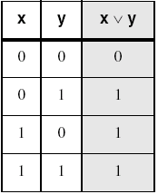
OR Instruction
Performs a Boolean OR operation between each pair of matching bits in two operands
Syntax: OR destination, source
OR

Slide 10
OR Instruction
Flags
The OR instruction always clears the Carry and Overflow flags.
It modifies the Sign, Zero, and Parity flags
consistent with the value assigned to the destination operand.
Example: OR a number with itself (or zero) to obtain certain information about its value:
or al,al

Slide 11
OR Instruction
The values of the Zero and Sign flags indicate the following about the contents of AL:

Slide 12
OR Example
Task: Jump to a label if the value in AL is not zero.
Solution: OR the byte with itself, then use the JNZ (jump if not zero) instruction.
or al,al
jnz IsNotZero ; jump if not zero
ORing any number with itself does not change its value.

Slide 13
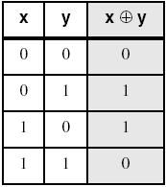
XOR Instruction
Performs a Boolean exclusive-OR operation between each pair of matching bits in two operands
Syntax: XOR destination, source
XOR
XOR is a useful way to toggle (invert) the bits in an operand.

Slide 14
XOR Instruction
Example:
bit masking:
A bit exclusive-ORed with 0 retains its value,
A bit exclusive-ORed with 1 is toggle (complemented).
XOR
XOR is a useful way to toggle (invert) the bits in an operand.

Slide 15
XOR Instruction
Flags
The XOR instruction always clears the Overflow and Carry flags.
XOR modifies the Sign, Zero and Parity flags
consistent with the value assigned to the destination operand.
Example:
An effective way to check the parity of a number without changing its value is to exclusive-OR the number with zero:
The Parity flag (PF) is set when The least significant byte of the destination has an even number of 1 bits.
Notes:
Thursday, 06, Jully.

Slide 16
XOR Instruction : Another Property

Slide 17
XOR Application: Encrypting a String
The following loop uses the XOR instruction to transform every character in a string into a new value.
KEY = 239 ; can be any byte value between 1-255
BUFMAX = 128
.data
buffer BYTE BUFMAX+1 DUP(0)
bufSize DWORD BUFMAX
.code
mov ecx,bufSize ; loop counter
mov esi,0 ; index 0 in buffer
L1:
xor buffer[esi],KEY ; translate a byte
inc esi ; point to next byte
loop L1
Enter the plain text: Attack at dawn.
Cipher text: «¢¢Äîä-Ä¢-ïÄÿü-Gs
Decrypted: Attack at dawn.

Slide 18
XOR Application: Encrypting a String
Tasks:
Input a message (string) from the user
Encrypt the message
Display the encrypted message
Decrypt the message
Display the decrypted message
View the Encrypt.asm program's source code. Sample output:
Enter the plain text: Attack at dawn.
Cipher text: «¢¢Äîä-Ä¢-ïÄÿü-Gs
Decrypted: Attack at dawn.

Slide 19
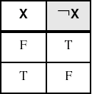
NOT Instruction
Performs a Boolean NOT operation on a single destination operand
Syntax: NOT destination
NOT
Flags
No flags are affected by the NOT instruction.

Slide 20
TEST Instruction
Performs a nondestructive AND operation between each pair of matching bits in two operands
No operands are modified
Sets the Sign, Zero, and Parity flags based on the value assigned to the destination operand.
Example 1: jump to a label if either bit 0 or bit 1 in AL is set.
test al,00000011b
jnz ValueFound
ZF = ?
Notes:
Tus, Oct 10, 2017

Slide 21
CMP Instruction
The most common boolean expressions involve some type of comparison:
if A > B ...
while X > 0 and X < 200 ...
if check_for_error( N ) = true
CMP instruction is used to compare integers (signed and unsigned)
Compares the destination operand to the source operand (HOW 🤔)
CMP performs implied subtraction of source operand from destination operand
Nondestructive subtraction of source from destination (destination operand is not changed)
Syntax:
🗝
CMP destination, source
Notes:
Wed, Oct-11,3pm

Slide 22
CMP Instruction (unsigned )
Flags
The CMP instruction changes the Overflow, Sign, Zero, Carry, Auxiliary Carry, and Parity flags
According to the value the destination operand would have had if actual subtraction had taken place.
When two unsigned operands are compared,
Zero and Carry flags indicate the following relations between operands:
Why CF is 1?

Slide 23
CMP Instruction (signed )
Flags
2) When two signed operands are compared,
the Sign, Zero, and Overflow flags indicate the following relations between operands:

Slide 24
CMP Instruction (unsigned integers)
The comparisons shown here are performed with unsigned integers.
Example1: destination == source
mov al,5
cmp al,5 ; Zero flag set
Example2: destination < source
mov al,4
cmp al,5 ; Carry flag set
😳

Slide 25
CMP Instruction (unsigned integers)
Example3: destination > source
mov al,6
cmp al,5 ; ZF = 0, CF = 0
(both the Zero and Carry flags are clear)

Slide 26
CMP Instruction (signed integers)
The comparisons shown here are performed with signed integers
Example1: destination > source
mov al,5
cmp al,-2 ; Sign flag == Overflow flag
😳
Example2: destination < source
mov al,-1
cmp al,5 ; Sign flag != Overflow flag

Slide 27
Outline
Boolean and Comparison Instructions
Conditional Jumps
Conditional Structures
Conditional Control Flow Directives
if A > B ...
while X > 0 and X < 200 ...
Implement high-level logic structures using a combination of
comparisons and jumps.
cmp eax,0
jz L1 ; jump if ZF = 1
Notes:
Oct12-TH,4pm

Slide 29
Conditional Jumps
🗝
Compare and then Jump
Jumps Based On . . .
Specific flags
Equality
Unsigned comparisons
Signed Comparisons
Applications
Search of an Array
First, an operation such as CMP, AND, or SUB modifies the CPU status flags.
Second, a conditional jump instruction tests the flags and causes a branch to a new address.

Slide 30
Jcond Instruction
A conditional jump instruction branches to a label
When specific status flag condition is true
Syntax
Jcond destination
cond refers to a flag condition identifying the state of one or more flags.
The following examples are based on the Carry and Zero flags:
CPU status flags are most commonly set by
arithmetic, comparison, and boolean instructions.

Slide 31
Conditional Jumps (Example1)
First, an operation such as CMP, AND, or SUB modifies the CPU status flags.
Second, a conditional jump instruction tests the flags and causes a branch to a new address.
🗝
Compare and then Jump or NOT
- The CMP instruction compares EAX to Zero.
The JZ (Jump if zero) instruction jumps to label L1 if the Zero flag was set by the CMP instruction:
cmp eax,0
jz L1 ; jump if ZF = 1
.
.
L1:
.
.

Slide 32
Conditional Jumps (Example2)
First, an operation such as CMP, AND, or SUB modifies the CPU status flags.
Second, a conditional jump instruction tests the flags and causes a branch to a new address.
🗝
Compare and then Jump
The AND instruction performs a bitwise AND on the DL register, affecting the Zero flag.
The JNZ (jump if not Zero) instruction jumps if the Zero flag is clear:
and dl,10110000b
jnz L2 ; jump if ZF = 0
.
.
L2:

Slide 33
Types of Conditional Jumps Instructions
Conditional jump instructions are able to
Compare signed and unsigned integers and
Perform actions based on the values of individual CPU flags.
The conditional jump instructions can be divided into four groups:
Jumps based on specific flag values
Jumps based on equality between operands or the value of (E)CX
Jumps based on comparisons of unsigned operands
Jumps based on comparisons of signed operands

Slide 34
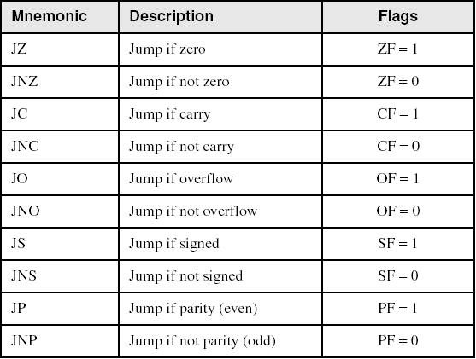
Jumps Based on Specific Flags

Slide 35
Jumps Based on Equality
CMP leftOp, rightOp

Slide 36
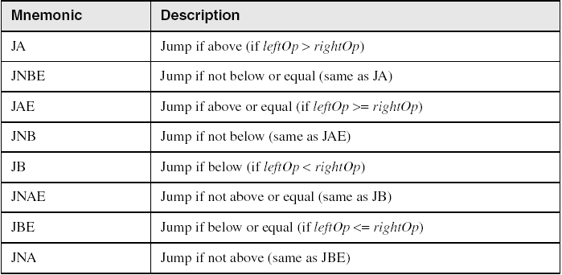
Jumps Based on Unsigned Comparisons
CMP leftOp, rightOp
A and B

Slide 37
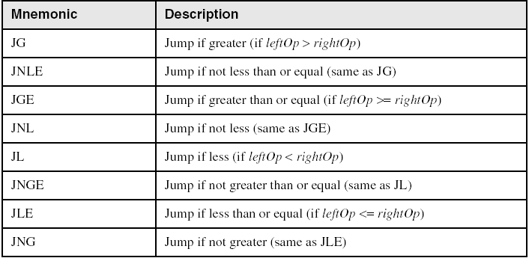
Jumps Based on Signed Comparisons
CMP leftOp, rightOp
G and L

Slide 38
Conditional Jumps
Jumps Based On . . .
Specific flags
Equality
Unsigned comparisons
Signed Comparisons
Applications
Search of an Array

Slide 39
Applications 1
Task: Jump to a label if unsigned EAX is greater than EBX
Solution: Use CMP, followed by JA
cmp eax,ebx
ja Larger ;jump if above
A and B
Task: Jump to a label if signed EAX is greater than EBX
Solution: Use CMP, followed by JG
cmp eax,ebx
jg Greater ; jump if greater
G and L

Slide 40
Applications 2
Jump to label L1 if unsigned EAX is less than or equal to Val1
cmp eax,Val1
jbe L1 ; below or equal
A and B
Jump to label L1 if signed EAX is less than or equal to Val1
cmp eax,Val1
jle L1
G and L

Slide 41
Applications 3
Compare unsigned AX to BX, and copy the larger of the two into a variable named Large
mov Large,bx
cmp ax,bx
jna Next
mov Large,ax
Next:
A and B
Compare signed AX to BX, and copy the smaller of the two into a variable named Small
mov Small,ax
cmp bx,ax
jnl Next
mov Small,bx
Next:
G and L

Slide 42
Applications 4
Jump to label L1 if the memory word pointed to by ESI equals Zero
cmp WORD PTR [esi],0
je L1
Jump to label L2 if the doubleword in memory pointed to by EDI is even
test DWORD PTR [edi],1
jz L2

Slide 43
Applications 5
Task: Jump to label L1 if bits 0, 1, and 3 in AL are all set.
Solution: 1. Clear all bits except bits 0, 1,and 3.
2. Then compare the result with 00001011 binary.
and al,00001011b ; clear unwanted bits
cmp al,00001011b ; check remaining bits
je L1 ; all set? jump to L1

Slide 44
Conditional Jumps
Jumps Based On . . .
Specific flags
Equality
Unsigned comparisons
Signed Comparisons
Applications
Search of an Array

Slide 45
Search of an Array
A common programming task is to search for values in an array that meet some criteria
Example:
The following program looks for the first nonzero value in an array of 16-bit integers
If it finds one, it displays the value
Otherwise, it displays a message stating that a nonzero value was not found

Slide 47
Why use ebx and not esi?
WriteInt
Writes a signed 32-bit integer to the console window in decimal format.
WriteString Writes a null-terminated string to the console window.
Crlf:
Writes an end-of-line sequence to the console window.
Notes:
Mon, Oct,16,3pm

Slide 48
Outline
Boolean and Comparison Instructions
Conditional Jumps
Conditional Structures
Conditional Control Flow Directives

Slide 49
Conditional Structures
Block-Structured IF Statements
Compound Expressions with AND
Compound Expressions with OR
WHILE Loops
Notes:
Oct-17-Tu,9:30

Slide 50
Conditional Structures
A conditional structure is defined to be one or more conditional expressions
Those conditional expressions trigger a choice between different logical branches
Each branch causes a different sequence of instructions to execute.
When the condition is true, execute the body
When the condition is false, don't execute the body, jump over it.

Slide 51
Block-Structured IF Statements
An IF structure imply that a boolean expression is followed by one or two lists of statements:
Two types:
1. IF-Then
Statement/s performed when the expression is true
Next statement/s performed when the expression is false:
.
.
.

Slide 52
Block-Structured IF Statements
2. IF-Then-Else
Statement/s performed when the expression is true
Another performed when the expression is false:
The else part is optional.

Slide 53
Block-Structured IF Statements
IF statement is translated into assembly language with a
CMP instruction followed by
Conditional jumps.
When op1 or op2 is a memory operand (a variable),
One of them must be moved to a register before executing CMP.

Slide 54
Block-Structured IF Statements
If ( AX > 10){
//if block code
}
else{
//else block code
}

Slide 55
Block-Structured IF Statements
CMP AX, 10
Jump (conditional) to ELSE if (AX>10) is FALSE
// if block code
Label:
// ELSE block code
If ( AX > 10){
//if block code
}
else{
//else block code
}

Slide 56
Block-Structured IF Statements
CMP AX, 10
Jump (conditional) to ELSE if (AX>10) is FALSE
// if block code
Label:
// ELSE block code
If ( AX > 10){
//if block code
}
else{
//else block code
}
Problem! : Conditional Jumps trigger when CONDITION is TRUE!

Slide 57
Block-Structured IF Statements
CMP AX, 10
Jump (conditional) to ELSE if (AX>10) is FALSE
// if block code
Label:
// ELSE block code
If ( AX > 10){
//if block code
}
else{
//else block code
}
Solution : Negate the condition
Now, it can jump when condition is TRUE.

Slide 58
Block-Structured IF Statements
When the condition is true, execute the body
When the condition is false, don't execute the body, jump over it.
This is the jump case
1
Thus, jump when the condition is false.
🗝
2
- x86 Jump instructions jump
when the condition is true
- Thus, we often need to reverse the condition.

Slide 59
Block-Structured IF Statements
How to reverse a condition?
Using DeMorgan's Law
In order to branch on a negated condition, we need to know the negation of various conditions
Condition | Negated Condition
x > y | x <= y
x >= y | x < y
x < y | x >= y
x <= y | x > y
= | !=
<cond1> && <cond1> | ! <cond1> || ! <cond2>
<cond1> || <cond1> | ! <cond1> && ! <cond2>

Slide 60
IF Statements: Example1 (IF-Then)
IF statement is translated into assembly language with a
CMP instruction followed by
Conditional jumps.
If op1 or op2 is a memory operand (a variable):
one of them must be moved to a register before executing CMP.
Implement the following pseudocode in assembly language.
All values are unsigned:
if( ebx <= ecx )
{
eax = 5;
edx = 6;
}
Reverse The IF Condition
(There are multiple correct solutions to this problem.)

Slide 61
IF Statements: Example1 (IF-Then)
IF statement is translated into assembly language with a
CMP instruction followed by
Conditional jumps.
If op1 or op2 is a memory operand (a variable):
one of them must be moved to a register before executing CMP.
Implement the following pseudocode in assembly language.
All values are unsigned:
if( ebx <= ecx )
{
eax = 5;
edx = 6;
}
cmp ebx,ecx
ja next
mov eax,5
mov edx,6
next:
A and B
Reverse The IF Condition
(There are multiple correct solutions to this problem.)

Slide 62
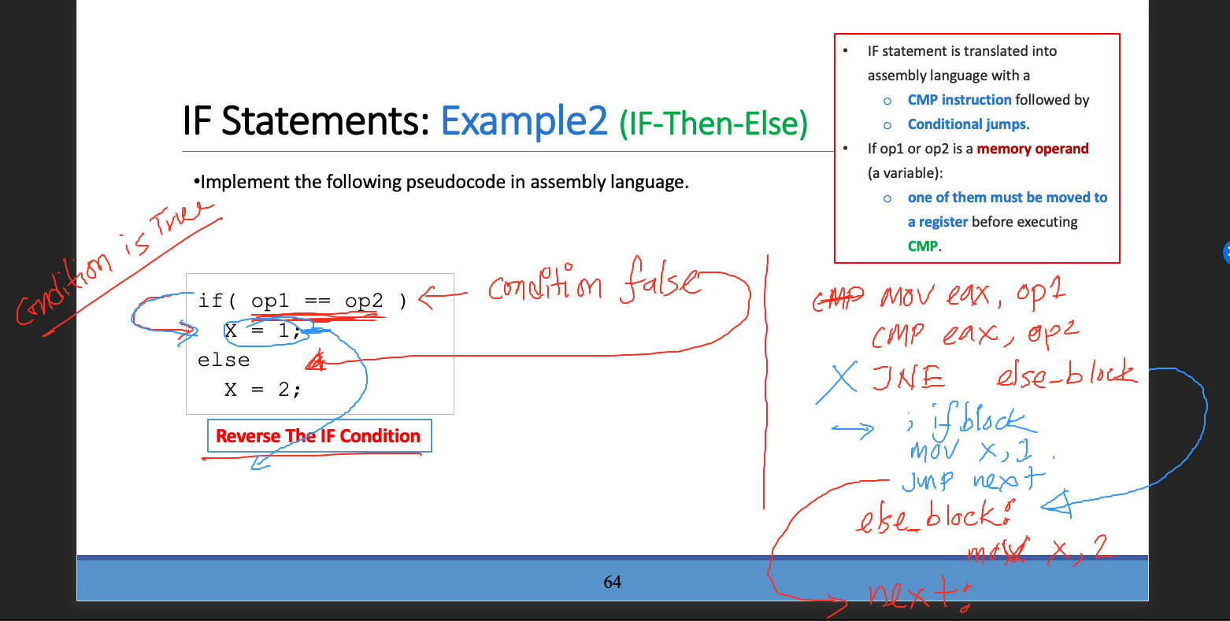

Slide 63
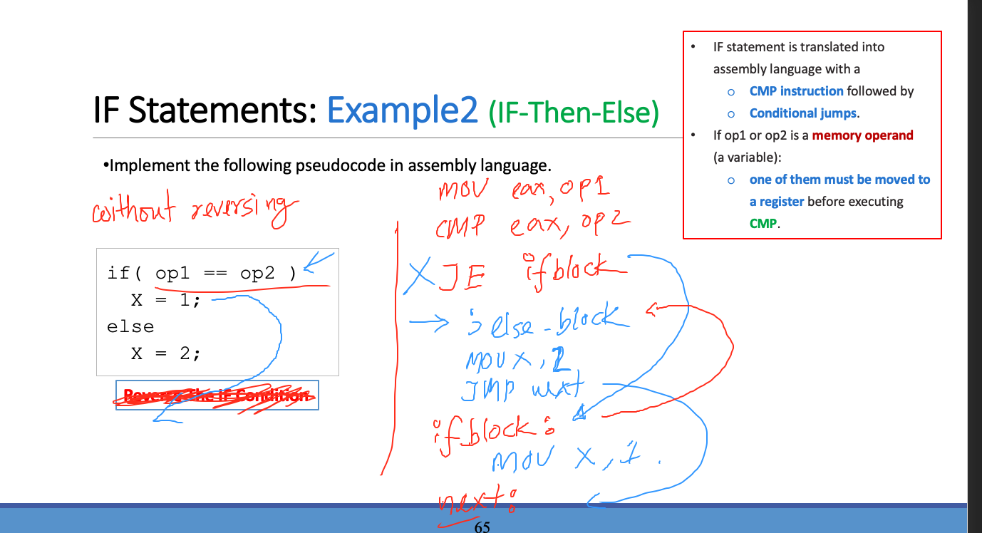
IF Statements: Example2 (IF-Then-Else)
IF statement is translated into assembly language with a
CMP instruction followed by
Conditional jumps.
If op1 or op2 is a memory operand (a variable):
one of them must be moved to a register before executing CMP.
Implement the following pseudocode in assembly language.
if( op1 == op2 )
X = 1;
else
X = 2;
Reverse The IF Condition
Notes:
Sec03 Mar 28th

Slide 64
IF Statements: Example2 (IF-Then-Else)
IF statement is translated into assembly language with a
CMP instruction followed by
Conditional jumps.
If op1 or op2 is a memory operand (a variable):
one of them must be moved to a register before executing CMP.
Implement the following pseudocode in assembly language.
mov eax,op1
cmp eax,op2
jne L1
mov X,1
jmp L2
L1: mov X,2
L2:
if( op1 == op2 )
X = 1;
else
X = 2;
Reverse The IF Condition
Notes:
Sec03 Mar 28th

Slide 65
IF Statements: Example3 (IF-Then-Else)
IF statement is translated into assembly language with a
CMP instruction followed by
Conditional jumps.
If op1 or op2 is a memory operand (a variable):
one of them must be moved to a register before executing CMP.
Implement the following pseudocode in assembly language.
All values are 32-bit signed integers:
if( var1 <= var2 )
var3 = 10;
else
{
var3 = 6;
var4 = 7;
}
Do not Reverse the Condition
(There are multiple correct solutions to this problem.)

Slide 66
IF Statements: Example3 (IF-Then-Else)
IF statement is translated into assembly language with a
CMP instruction followed by
Conditional jumps.
If op1 or op2 is a memory operand (a variable):
one of them must be moved to a register before executing CMP.
Implement the following pseudocode in assembly language.
All values are 32-bit signed integers:
if( var1 <= var2 )
var3 = 10;
else
{
var3 = 6;
var4 = 7;
}
1. Compare two operands
2. If condition TRUE
jump to IF BLOCK
3. ELSE Block
4. Jump over IF block
5. IF block
Do not Reverse the Condition
(There are multiple correct solutions to this problem.)

Slide 67
IF Statements: Example3 (IF-Then-Else)
IF statement is translated into assembly language with a
CMP instruction followed by
Conditional jumps.
If op1 or op2 is a memory operand (a variable):
one of them must be moved to a register before executing CMP.
Implement the following pseudocode in assembly language.
All values are 32-bit signed integers:
if( var1 <= var2 )
var3 = 10;
else
{
var3 = 6;
var4 = 7;
}
mov eax,var1
cmp eax,var2
jle L1
mov var3,6
mov var4,7
jmp L2
L1: mov var3,10
L2:
Do not Reverse the Condition
G and L
(There are multiple correct solutions to this problem.)

Slide 68
Conditional Structures
Block-Structured IF Statements
Compound Expressions with AND
Compound Expressions with OR
WHILE Loops
Notes:
Sec06 Mar 27th
Sec09 Mar 28th

Slide 69
Attendance

Slide 70
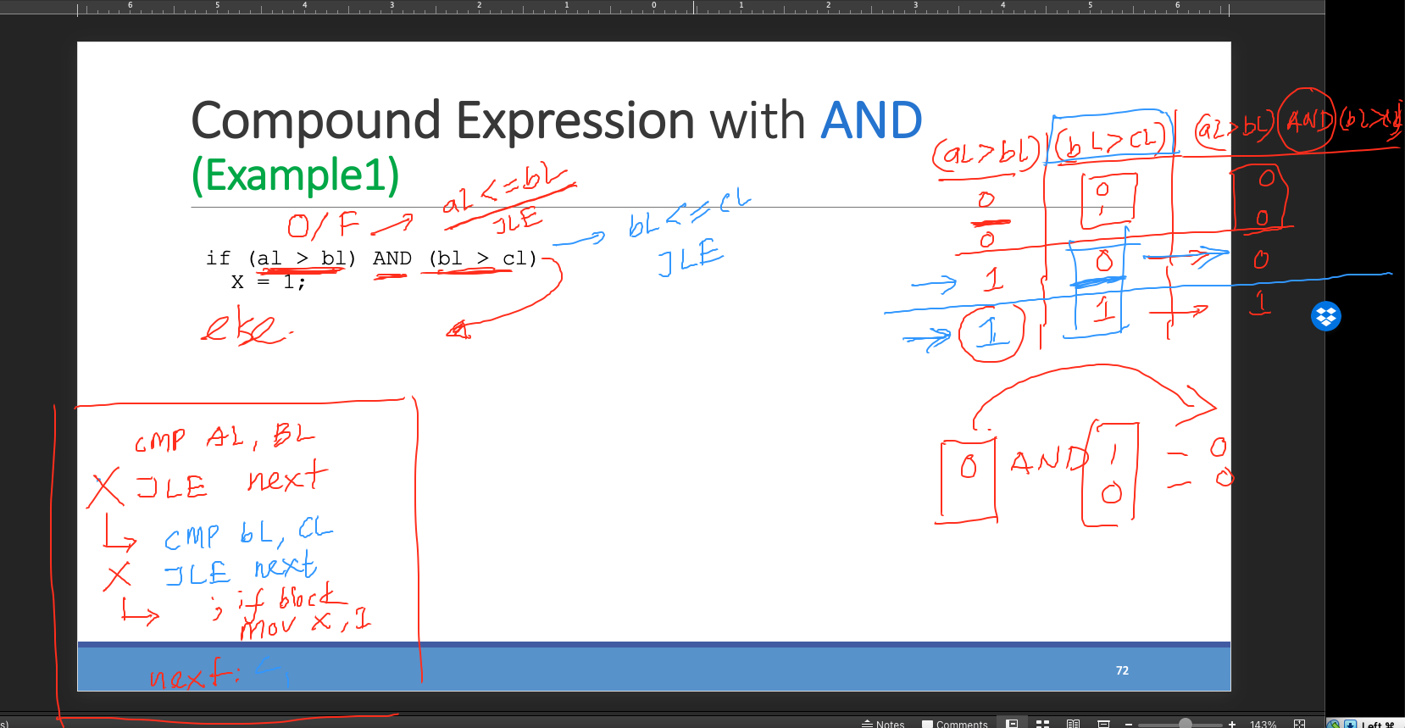
Compound Expression with AND (Example1)
if (al > bl) AND (bl > cl)
X = 1;

Slide 71
Compound Expression with AND (Example1)
When implementing the logical AND operator, consider that HLLs use short-circuit evaluation
In the following example, if the first expression is false, the second expression is skipped:
cmp al,bl ; first expression...
ja L1
jmp next
L1:
cmp bl,cl ; second expression...
ja L2
jmp next
L2: ; both are true
mov X,1 ; set X to 1
next: …
if (al > bl) AND (bl > cl)
X = 1;
Do not Reverse
A and B

Slide 72
Compound Expression with AND (Example1)
if (al > bl) AND (bl > cl)
X = 1;
Reverse The IF Condition

Slide 73
Compound Expression with AND (Example2)
But the following implementation uses 29% less code by reversing the first relational operator.
We allow the program to "fall through" to the second expression:
if (al > bl) AND (bl > cl)
X = 1;
Reverse The IF Condition
cmp al,bl ; first expression...
jbe next ; quit if false
cmp bl,cl ; second expression...
jbe next ; quit if false
mov X,1 ; both are true
next:
.
.

Slide 74
if (al > bl) AND (bl > cl)
X = 1;
cmp al,bl ; first expression...
ja L1
jmp next
L1:
cmp bl,cl ; second expression...
ja L2
jmp next
L2: ; both are true
mov X,1 ; set X to 1
next:
Method 1
Do not Reverse the Condition
cmp al,bl ; first expression...
jbe next ; quit if false
cmp bl,cl ; second expression...
jbe next ; quit if false
mov X,1 ; both are true
next:
Method 2
Reverse the Condition

Slide 75
Compound Expression with AND (Example3)
Implement the following pseudocode in assembly language.
All values are unsigned:
if( ebx <= ecx
&& ecx > edx )
{
eax = 5;
edx = 6;
}
cmp ebx,ecx
ja next
cmp ecx,edx
jbe next
mov eax,5
mov edx,6
next:
Reverse The IF Condition
(There are multiple correct solutions to this problem.)

Slide 76
Conditional Structures
Block-Structured IF Statements
Compound Expressions with AND
Compound Expressions with OR
WHILE Loops

Slide 77
Compound Expression with OR
if (al > bl) OR (bl > cl)
X = 1;
Reverse the second Condition

Slide 78
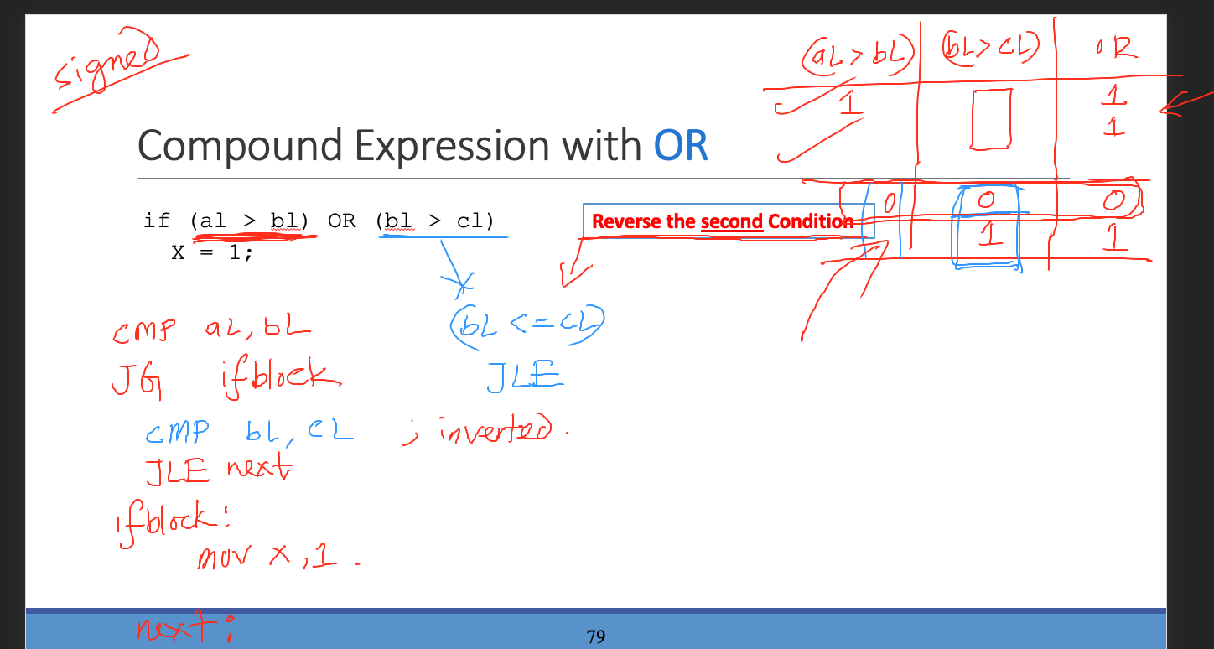

Slide 79
Compound Expression with OR
In the following implementation, the code branches to L1
if the first expression is true
otherwise, it falls through to the second CMP instruction.
The second expression reverses the > operator and uses JBE instead:
cmp al,bl ; is AL > BL?
ja L1 ; yes
cmp bl,cl ; no: is BL > CL?
jbe next ; no: skip next statement
L1: mov X,1 ; set X to 1
next:
if (al > bl) OR (bl > cl)
X = 1;
Reverse the second Condition

Slide 80
Conditional Structures
Block-Structured IF Statements
Compound Expressions with AND
Compound Expressions with OR
WHILE Loops

Slide 81
WHILE Loops
A WHILE loop tests a condition first before performing a block of statements.
As long as the loop condition remains true, the statements are repeated.
When implementing this structure in assembly language,
it is convenient to reverse the loop condition
and jump to endwhile if a condition becomes true

Slide 82
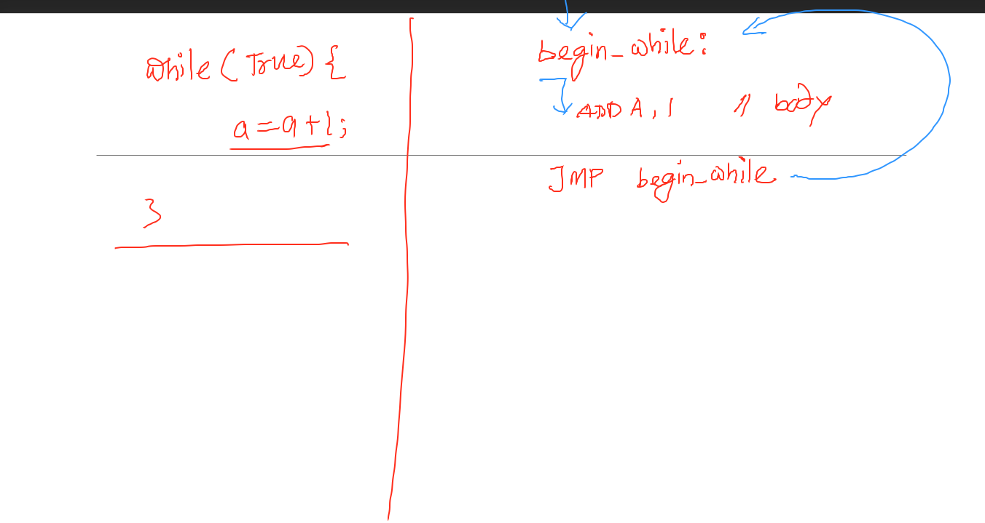

Slide 83
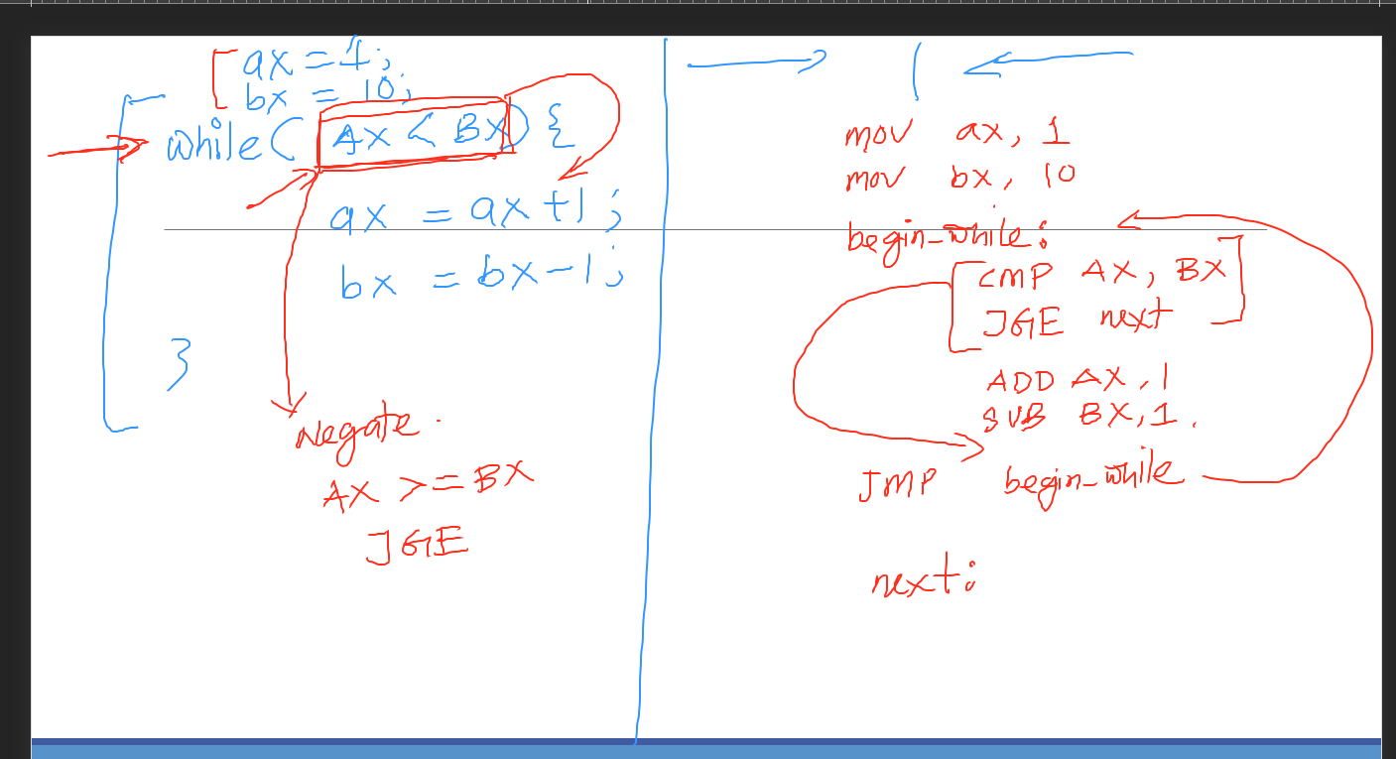

Slide 84
WHILE Loops: Example1
Reverse The loop Condition
G and L
Notes:
Verify this: jnl and jnle
Tu, Oct, 17, 4pm

Slide 85
WHILE Loops: Example1
mov eax,val1 ; copy variable to EAX?
beginwhile:
cmp eax,val2 ; if not (val1 < val2)
jge endwhile ; exit the loop
inc eax ; val1++;
dec val2 ; val2--;
jmp beginwhile ; repeat the loop
endwhile:
mov val1,eax ; save new value for val1
Reverse The loop Condition
G and L
Notes:
Verify this: jnl and jnle
Tu, Oct, 17, 4pm

Slide 87
WHILE Loops: Example2
A and B
top:
cmp eax,ebx ; check loop condition
jae next ; false? exit loop
inc eax ; body of loop
jmp top ; repeat the loop
next:
while( eax < ebx)
eax = eax + 1;
Reverse The loop Condition
This is a possible implementation

Slide 88
WHILE Loops: Example3
Implement the following loop, using unsigned 32-bit integers:
while( ebx <= val1)
{
ebx = ebx + 5;
val1 = val1 - 1
}
top: cmp ebx,val1 ; check loop condition
ja next ; false? exit loop
add ebx,5 ; body of loop
dec val1
jmp top ; repeat the loop
next:
Reverse The loop Condition
A and B

Slide 89
WHILE Loops: Example 4
Calculates the sum of all
array elements greater than the value in sample (50)
IF statement Nested in a Loop

Slide 90
WHILE Loops: Example 4
IF statement Nested in a Loop

Slide 91
WHILE Loops: Example 4
😳
40/4 = 10
IF statement Nested in a Loop
Loop
IF

Slide 92
Outline
Boolean and Comparison Instructions
Conditional Jumps
Conditional Structures
Application: Finite-State Machines See the book
Conditional Control Flow Directives See the book

Slide 93
Summary
Bitwise instructions (AND, OR, XOR, NOT, TEST)
manipulate individual bits in operands
CMP – compares operands using implied subtraction
sets condition flags
Conditional Jumps & Loops
equality: JE, JNE
flag values: JC, JZ, JNC, JP, ...
signed: JG, JL, JNG, ...
unsigned: JA, JB, JNA, ...
LOOPZ, LOOPNZ, LOOPE, LOOPNE (Just know them)
Conditional Structures
IF statement
While loop

